Slide 1
Integration
Parametric Int., Partial Fractions, Trig Substitutions

Slide 2
Parametric Integration
Just as we can differentiate parametrically, we can integrate parametrically.
For example, integrating inside ellipses or (sideways) parabolas!

Slide 3


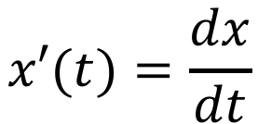

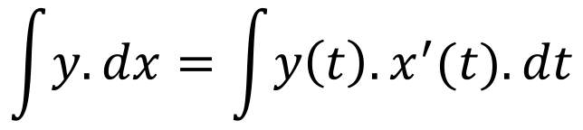

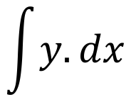
Parametric Integration
If there are limits, you need to change them from $x$-based to $t$-based.
$$\int{y.dx}$$
$$y=y(t)$$
$$x=x(t)$$
$$x′(t)=\frac{dx}{dt}$$
$$dx=x^{′}(t). dt$$
$$\int{y.dx}=\int{y\left(t\right).x^{′}(t).dt}$$

Slide 4
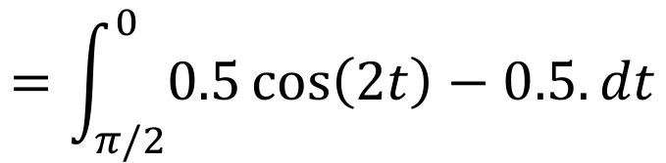



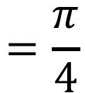
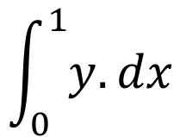




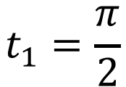


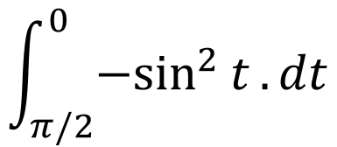
Example
$$\int_{0}^{1}{y.dx}$$
$$x=\cos{t}$$
Integrate
where
$$y=\sin{t}$$
$$t_{1}=\frac{π}{2}$$
$$0=\cos{t_{1}}$$
$$x′=−sin{t}$$
$$1=\cos{t_{2}}$$
$$t_{2}=0$$
$$\int_{π/2}^{0}{{−sin}^{2}{t}.dt}$$
$$=\int_{π/2}^{0}{0.5\cos\left(2t\right)−0.5.dt}$$
$$0$$
$$=0.25\sin\left(2t\right)−0.5t$$
$$=\frac{π}{4}$$
$$π/2$$

Slide 5
Partial Fractions
We’ve learned how to integrate lots of different functions now, using substitution, integration by parts, and parametric integration.
However, there are still things we can’t integrate! For example, a quotient where we can’t successfully use substitution.
This is hard to describe, so I will give an example.

Slide 6


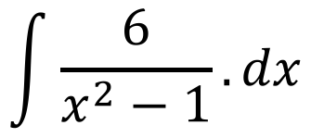
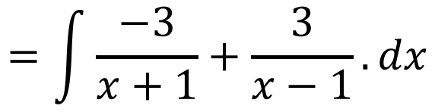
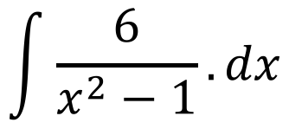
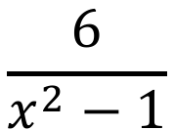
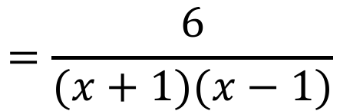
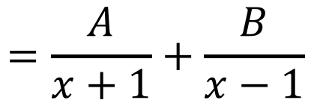
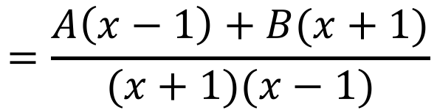




Example 1
$$\int{\frac{6}{x^{2}−1}.dx}$$
Integrate
$$\frac{6}{x^{2}−1}$$
$$=\frac{6}{(x+1)(x−1)}$$
$$=\frac{A}{x+1}+\frac{B}{x−1}$$
$$=\frac{A\left(x−1\right)+B(x+1)}{(x+1)(x−1)}$$
$$6=B−A$$
$$0=A+B$$
$$\int{\frac{6}{x^{2}−1}}.dx$$
$$=\int{\frac{−3}{x+1}+\frac{3}{x−1}.dx}$$
$$A=−B$$
$$6=2B$$
$$B=3$$
$$A=−3$$
$$=−3\ln\left|x+1\right|+3\ln\left|x−1\right|+C$$

Slide 7
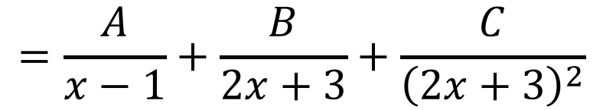
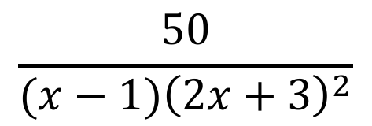
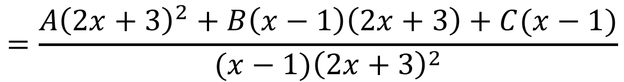



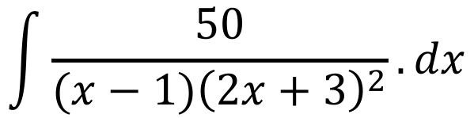
Example 2
Repeated roots need
repeated fractions!
$$\int{\frac{50}{(x−1){\left(2x+3\right)}^{2}}.dx}$$
Integrate
$$\frac{50}{(x−1){\left(2x+3\right)}^{2}}$$
$$=\frac{A}{x−1}+\frac{B}{2x+3}+\frac{C}{{\left(2x+3\right)}^{2}}$$
$$=\frac{A{\left(2x+3\right)}^{2}+B\left(x−1\right)\left(2x+3\right)+C(x−1)}{(x−1){\left(2x+3\right)}^{2}}$$
$$A=2$$
$$50=A{\left(2x+3\right)}^{2}+B\left(x−1\right)\left(2x+3\right)+C(x−1)$$
$$B=−4$$
$$50={(4A+2B)x}^{2}+(12A+B+C)x+(9A−3B−C)$$
$$C=−20$$

Slide 8
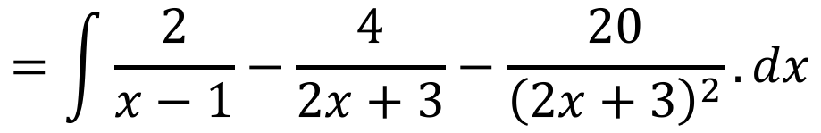
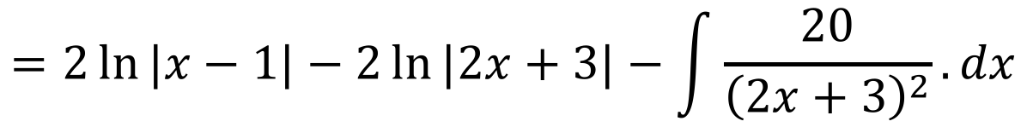
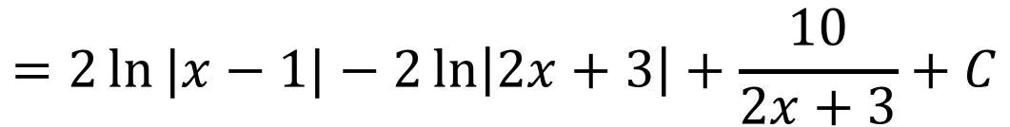
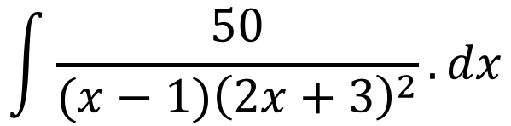
Example 2
We’ve had to use substitution for the last little bit
$$\int{\frac{50}{(x−1){\left(2x+3\right)}^{2}}.dx}$$
$$=\int{\frac{2}{x−1}−\frac{4}{2x+3}−\frac{20}{{\left(2x+3\right)}^{2}}.dx}$$
$$=2\ln{|x−1|}−2\ln{|2x+3|}−\int{\frac{20}{{\left(2x+3\right)}^{2}}.dx}$$
$$=2\ln{|x−1|}−2\ln\left|2x+3\right|+\frac{10}{2x+3}+C$$

Slide 9
Trigonometric Substitutions
Trigonometric substitutions occur when it is easier to handle the trigonometric form than the algebraic form. This is often used when we see a square root.
We will be using multiple steps of trigonometry and Pythagoras to find an appropriate substitution.

Slide 10
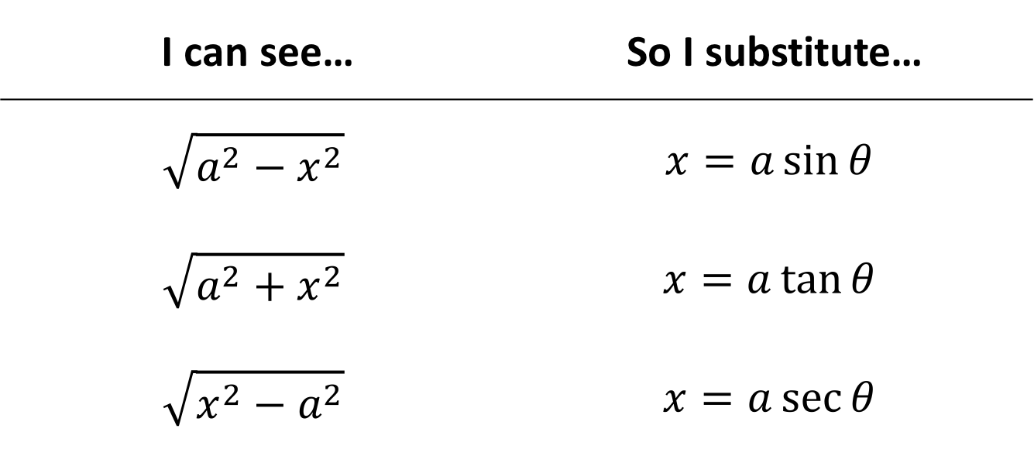
Common Substitutions
I can see… | So I substitute…
$$\sqrt{a^{2}−x^{2}}$$ | $$x=a\sin{θ}$$
$$\sqrt{a^{2}+x^{2}}$$ | $$x=a\tan{θ}$$
$$\sqrt{x^{2}−a^{2}}$$ | $$x=a\sec{θ}$$

Slide 11
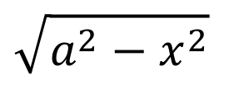

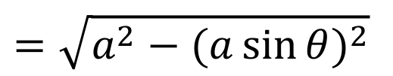
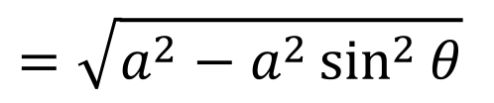
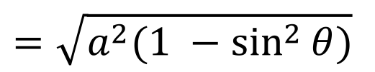
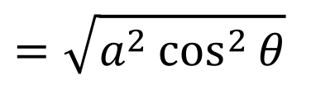

How do these work?
I’ll leave the rest to you as an exercise. They work in the same way.
Showing that the substitution is helpful:
$$\sqrt{a^{2}−x^{2}}$$
$$x=a\sin{θ}$$
$$=\sqrt{a^{2}−{(a\sin{θ})}^{2}}$$
$$=\sqrt{a^{2}−a^{2}\sin^{2}{θ}}$$
$$=\sqrt{a^{2}(1 −\sin^{2}{θ})}$$
$$=\sqrt{a^{2}\cos^{2}{θ}}$$
$$=a\cos{θ}$$

Slide 12
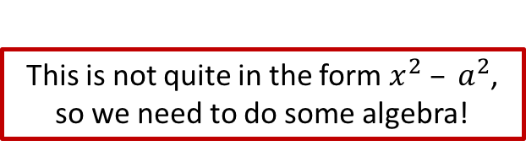
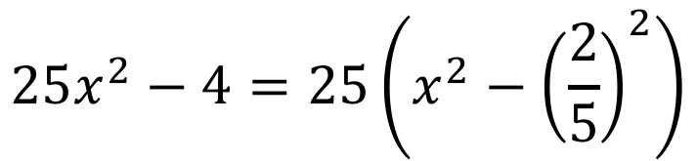
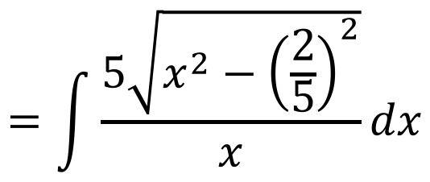
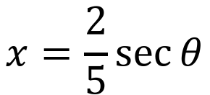
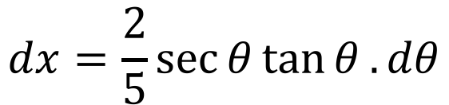
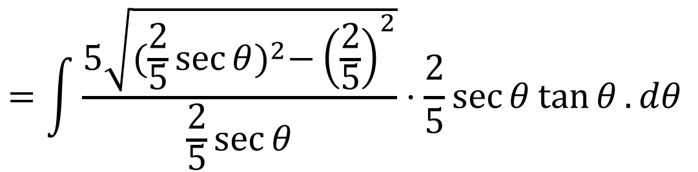
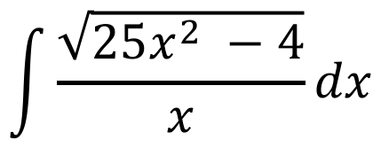
Example
This is not quite in the form $x^{2} – a^{2}$, so we need to do some algebra!
We can’t use a regular substitution here. Try it and it won’t work!
Integrate the following equation using a substitution:
$$\int{\frac{\sqrt{25x^{2} −4}}{x}dx}$$
$$25x^{2}−4=25\left(x^{2}−{\left(\frac{2}{5}\right)}^{2}\right)$$
$$=\int{\frac{5\sqrt{x^{2}−{\left(\frac{2}{5}\right)}^{2}}}{x}dx}$$
$$x=\frac{2}{5}\sec{θ}$$
$$dx=\frac{2}{5}\sec{θ}\tan{θ}.dθ$$
$$=\int{\frac{5\sqrt{{(\frac{2}{5}\sec{θ})}^{2}−{\left(\frac{2}{5}\right)}^{2}}}{\frac{2}{5}\sec{θ}}⋅\frac{2}{5}\sec{θ}\tan{θ}.dθ }$$

Slide 13
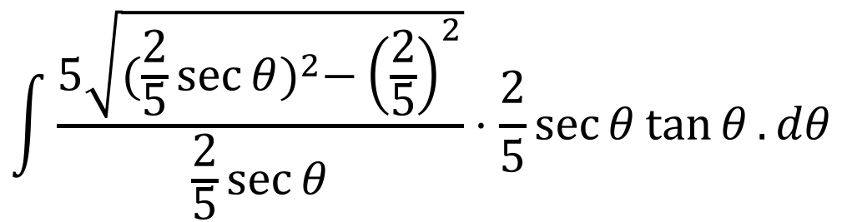
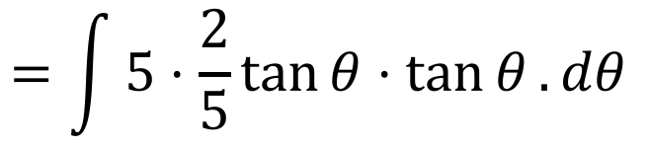
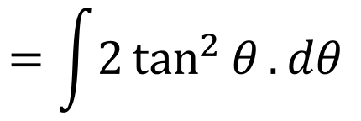
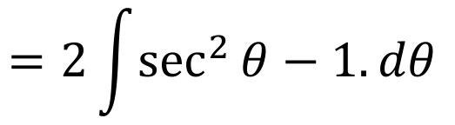


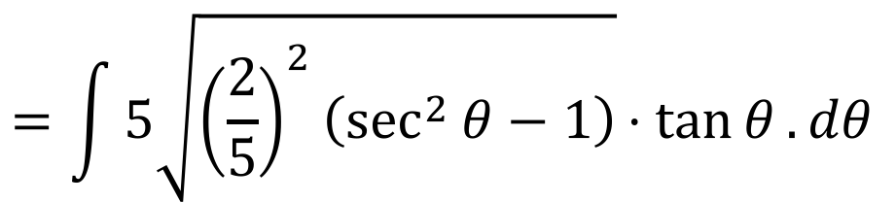
Example
We’re not done! We need to put this back in terms of $x$!
$$\int{\frac{5\sqrt{{(\frac{2}{5}\sec{θ})}^{2}−{\left(\frac{2}{5}\right)}^{2}}}{\frac{2}{5}\sec{θ}}⋅\frac{2}{5}\sec{θ}\tan{θ}.dθ }$$
$$=\int{5\sqrt{{\left(\frac{2}{5}\right)}^{2}\left(\sec^{2}{θ}−1\right)}⋅tan{θ}.dθ }$$
$$=\int{5⋅\frac{2}{5}\tan{θ}⋅\tan{θ}.dθ }$$
$$=\int{2\tan^{2}{θ}.dθ }$$
$$=2\int{\sec^{2}{θ}−1.dθ }$$
$$=2\tan{θ}−2θ+C$$

Slide 14
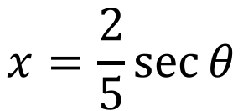
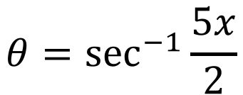
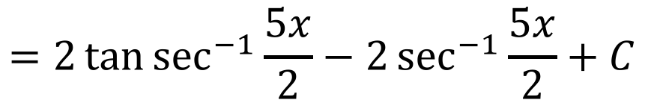




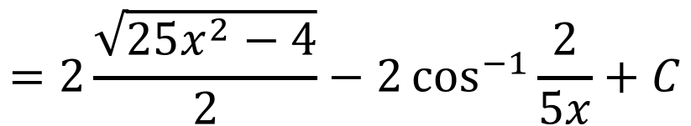
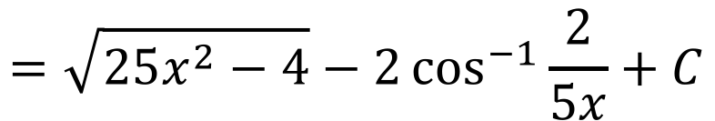

Example
$$x=\frac{2}{5}\sec{θ}$$
$$2\tan{θ}−2θ+C$$
$$=2\tan{\sec^{−1}{\frac{5x}{2}}}−2\sec^{−1}{\frac{5x}{2}}+C$$
$$θ=\sec^{−1}{\frac{5x}{2}}$$
$$θ$$
$$5x$$
$$=2\frac{\sqrt{25x^{2}−4}}{2}−2\cos^{−1}{\frac{2}{5x}}+C$$
$$2$$
$$\sqrt{25x^{2}−4}$$
$$=\sqrt{25x^{2}−4}−2\cos^{−1}{\frac{2}{5x}}+C$$

Slide 15
Do Now
Any Questions?
Delta Workbook
Sadly, nothing. This was the hard stuff!
Workbook
Pages 135-138, 153-155, 158-161

Slide 16

This work is licensed under a Creative Commons Attribution-NonCommercial-ShareAlike 4.0 International License.
Aaron Stockdill
2016

